Slide 1

High Impact Skills Development Program
in Artificial Intelligence, Data Science, and Blockchain
Module 3: Data Science Fundamentals
Lecture 3: Data Processing Tools
Maham Jahagir

Slide 2


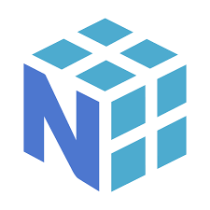


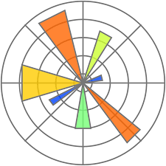


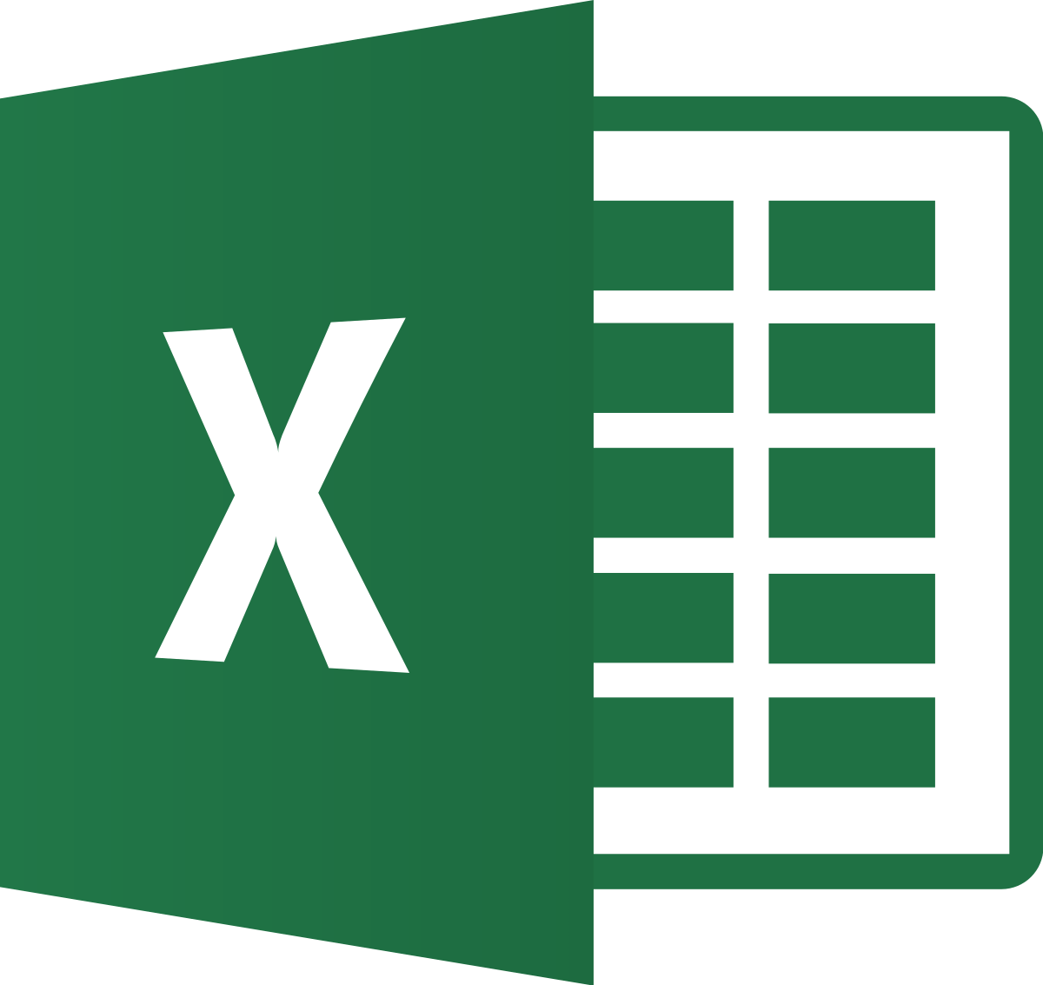







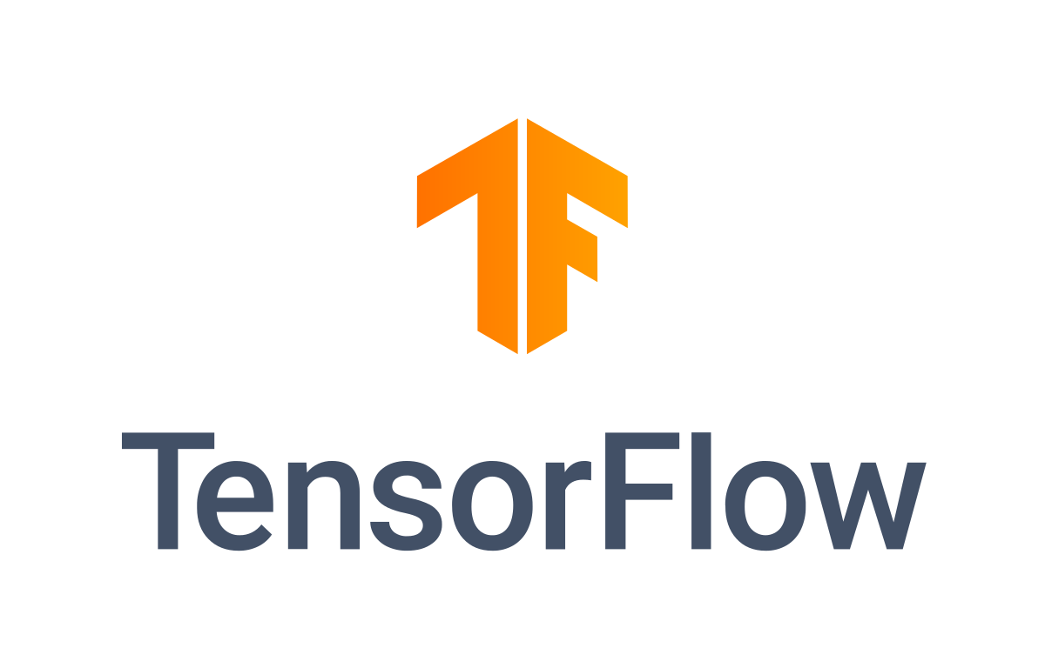



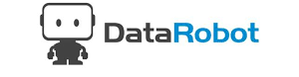


Recall!
Math
Visualization
Data Analysis
Coding/ Programming
numpy
Matlab
Matplot Lib
Python
Data Management
Excel
ML/AI
Pytorch
And Many more!
Weka

Slide 3


Data Processing Tools
distributed computing framework
enables processing of large datasets across clusters of computers.
Hadoop Distributed File System (HDFS) for storing and managing data
MapReduce for parallel processing.
Programming language
Comes with many libraries and packages specifically designed for data processing
e.g. NumPy, Pandas, and SciPy
Python
Programming language
Well suited for data analysis and statistical analysis
Pacakages such as dplyr, tidyr, and ggplot2, which facilitate data cleaning, transformation, and visualization.
distributed computing framework
provides fast and scalable data processing capabilities.
Supports in-memory processing (well-suited for iterative algorithms and interactive data exploration).
Structured Query Language (SQL)
essential for working with relational databases
efficiently extract, manipulate, and analyze data stored in databases using query statements.
distributed streaming platform
Handles real-time data streams.
It allows data ingestion, processing, and delivery of data streams across multiple systems or applications.
SQL

Slide 4


Data Processing Tools
Open-source deep learning framework maintained by Facebook's AI Research (FAIR) lab.
Popular for research and development of NN
Provides Python API, libraries for computer vision and NLP, and flexibility in model development
Open-source deep learning framework developed by Google.
Comprehensive ecosystem for building and deploying ML models.
Supports various neural network architectures and offers scalability.
Provides Python API, computational graphs, pre-built models, and deployment tools.
Pytorch
Powerful stream processing and batch processing framework
Low-latency, fault-tolerant data processing
Real-time stream processing and large-scale batch processing
Enables advanced analytics and real-time applications
A platform to programmatically author, schedule, and monitor workflows.
Used for data pipeline orchestration (to define and manage complex data processing pipelines)
Apache Flink
Apache Airflow
Business analytics tool developed by Microsoft.
Connects to multiple data sources, transforms data, and creates interactive visualizations.
User-friendly interface with drag-and-drop capabilities and data modeling features.
Supports collaboration, sharing, and publishing of reports and dashboards.
Powerful data visualization and business intelligence tool.
Connects to diverse data sources and creates interactive dashboards and reports.
User-friendly drag-and-drop interface, extensive visualization options, and advanced features.
MS Power BI

Slide 5
Rapidminer in action!

Slide 6
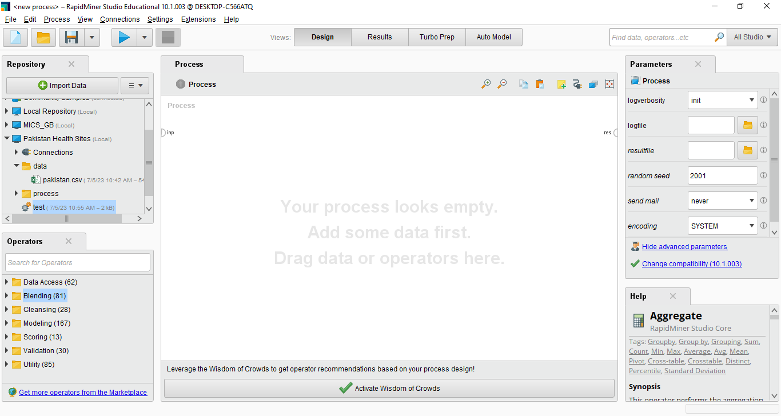
The main GUI

Slide 7
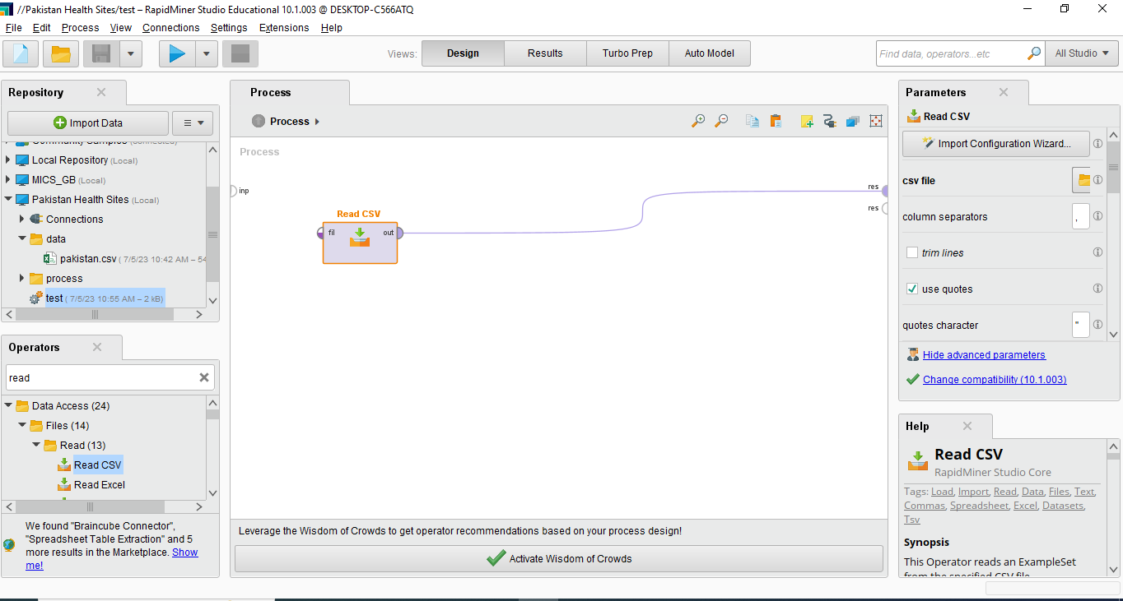
Read a CSV file

Slide 8
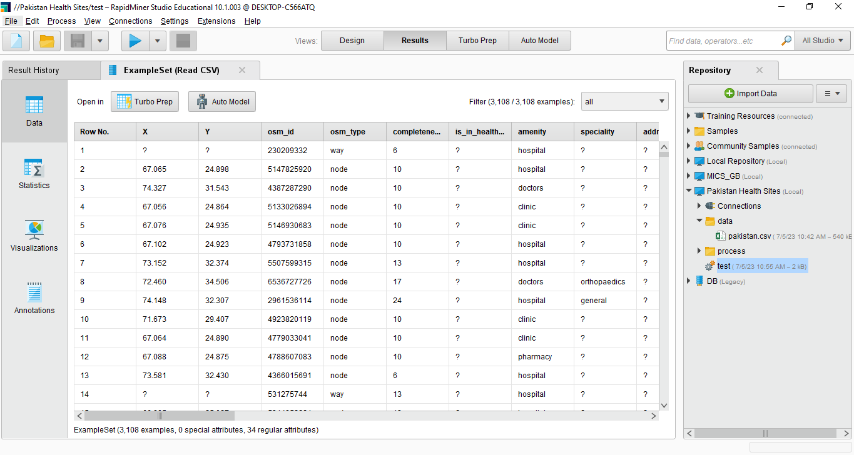
First run!

Slide 9

Happy Learning!

